Slide 1
BCDE222 – Assessment 2
Game Player – Sam Moulson

Slide 2
Expected Marks
MoSCoW - 5/5 marks
Class Diagram - 5/5 Marks
Implemented Requirements – (5/5)*3
Unit Tests – 5/5
All Tests Pass – 5/5
Total = 25/25

Slide 3
Must have features
5/5 marks
Must have a game board with cells
Must have ability to select next move
Must have correct movement for rook
Must have correct movement for bishop
Must have correct movement for knight
Must have correct movement for Queen
Must have correct movement for King
Must not accept incorrect movement (direction)
Must not accept movement to empty square
Must count moves
Must have start co-ordinates
Must have end co-ordinates
Must have undo button
Must have reset button
Must acknowledge level completion
Must display time taken to complete

Slide 4
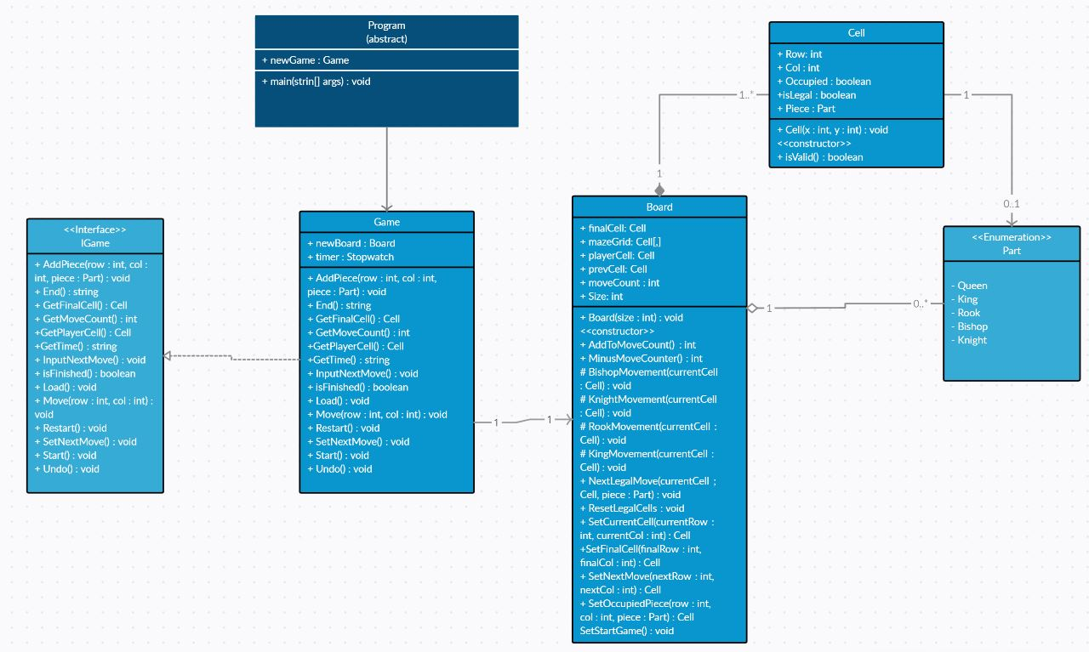
Class Diagram
5/5 marks

Slide 5
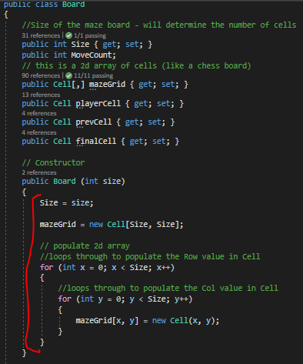
Feature 1 – Must Have a Game W/ Board Cells

Slide 6
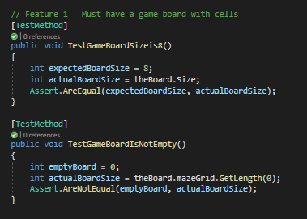
Test 1/2 – Must Have a Game W/ Board Cells

Slide 7
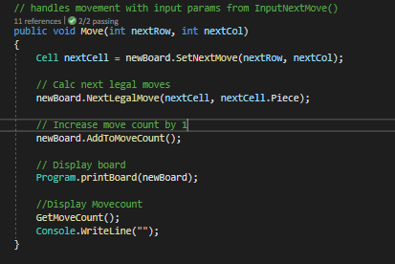
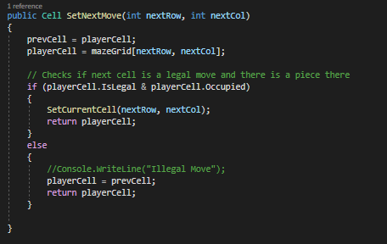
Feature 2 – Select next move
Game.cs
Board.cs

Slide 8
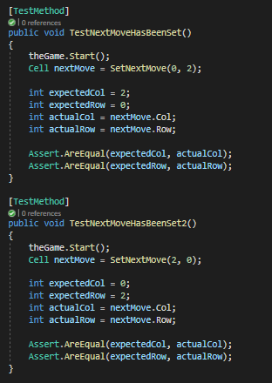
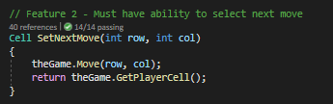
Test 3/4 – Next Move

Slide 9
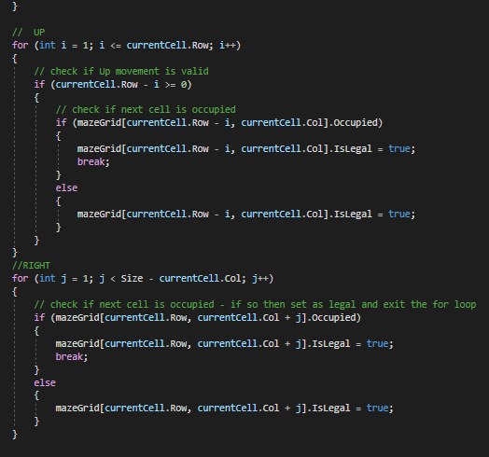
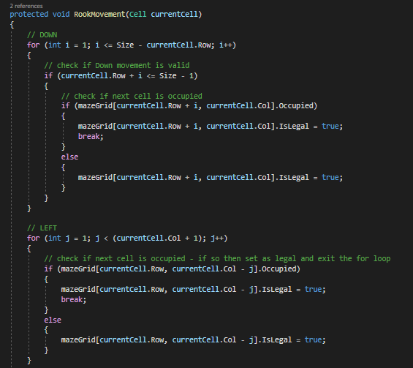
Feature 3 – Correct Rook Movement
Board.cs

Slide 10
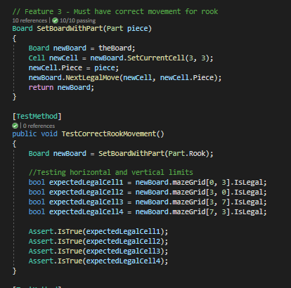
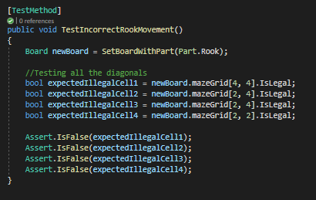
Test 5/6 – Correct Rook Movement

Slide 11
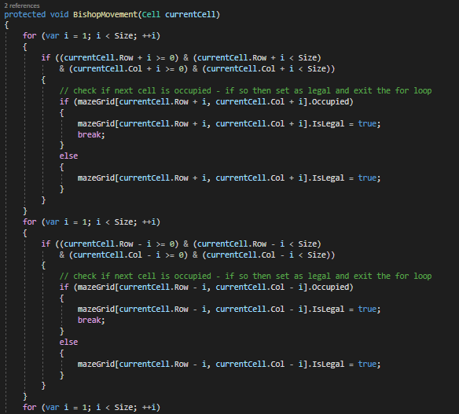
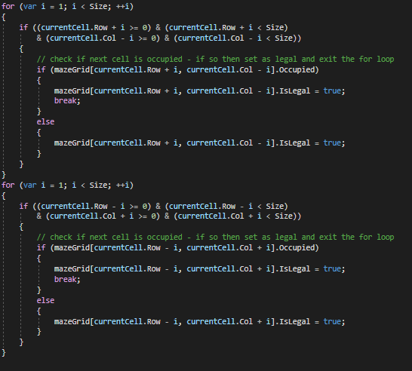
Feature 4 – Correct Bishop Movement
Board.cs

Slide 12
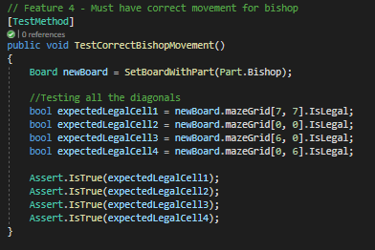
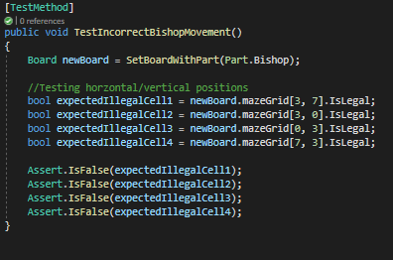
Test 7/8 – Correct Bishop Movement

Slide 13
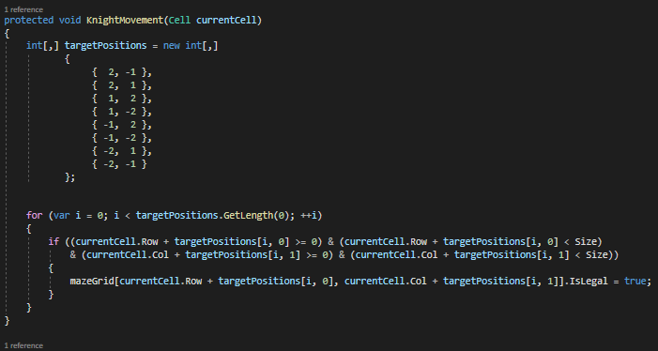
Feature 5 – Correct Knight Movement
Board.cs

Slide 14
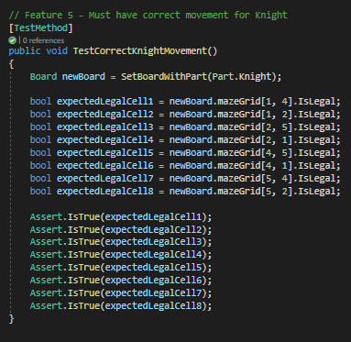
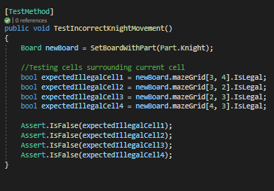
Test 9/10 – Correct Knight Movement

Slide 15
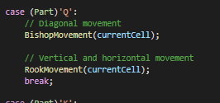
Feature 6 – Correct Queen Movement
Board.cs

Slide 16
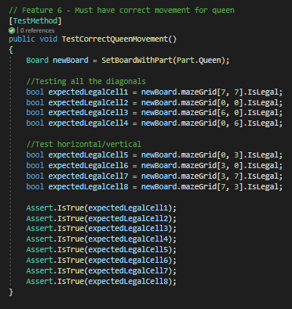
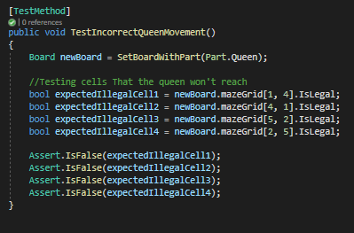
Test 11/12 – Correct Queen Movement

Slide 17
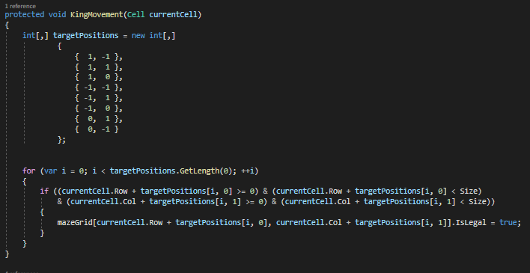
Feature 7 – Correct King Movement
Board.cs

Slide 18
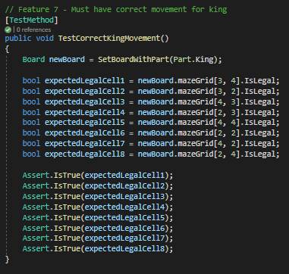
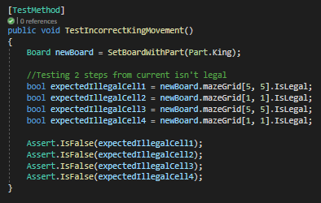
Test 13/14 – Correct King Movement

Slide 19
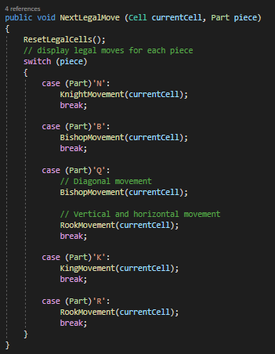
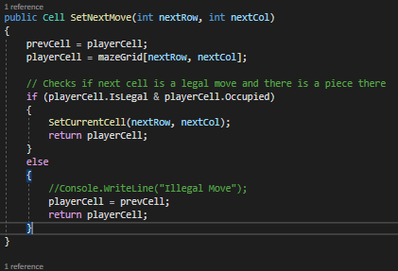
Feature 8 – No incorrect directions
Board.cs

Slide 20
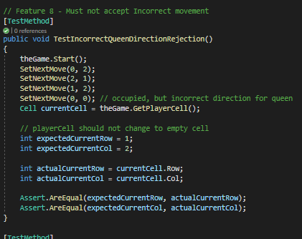
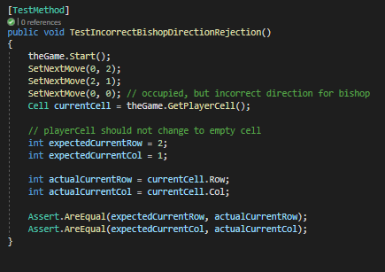
Test 15/16 – No incorrect directions

Slide 21
Feature 9 – Must not move to empty cells
Board.cs

Slide 22
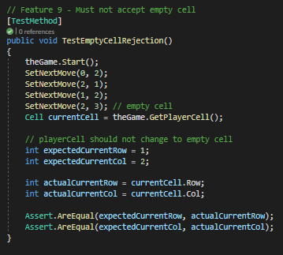
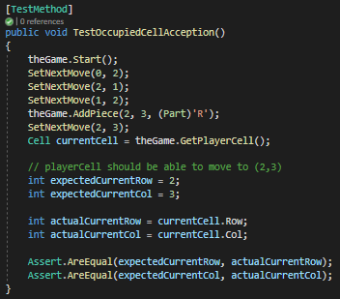
Test 17/18 – Must not move to empty cells

Slide 23
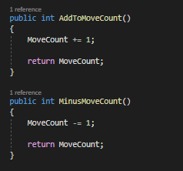
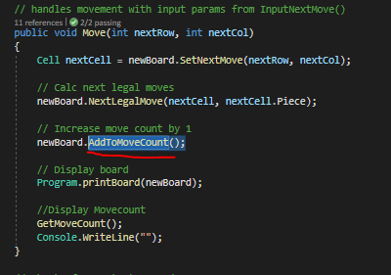
Feature 10 – Must Count moves
Board.cs
Game.cs

Slide 24
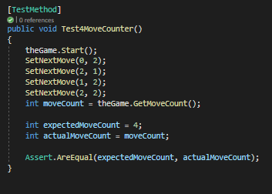
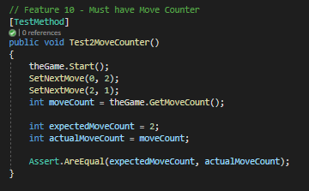
Test 19/20 – Must Count moves

Slide 25
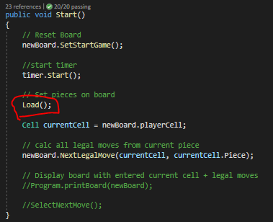
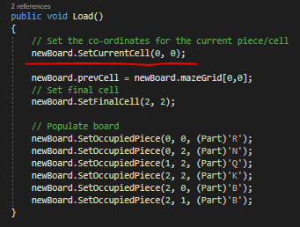
Feature 11 – Must have start co-ordinates
Game.cs

Slide 26
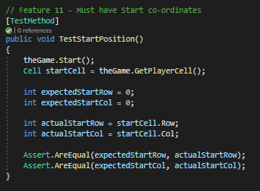
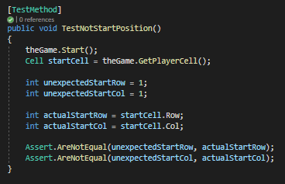
Test 21/22 – Must have start co-ordinates

Slide 27
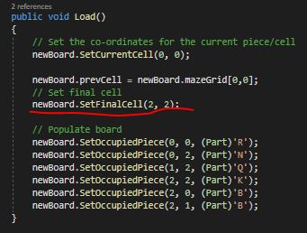
Feature 12 – Must have end co-ordinates
Game.cs

Slide 28
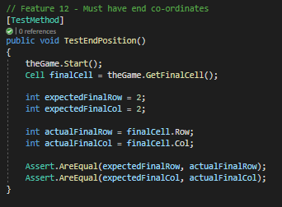
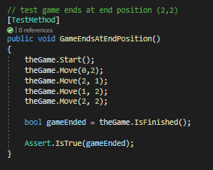
Test 23/24 – Must have end co-ordinates

Slide 29
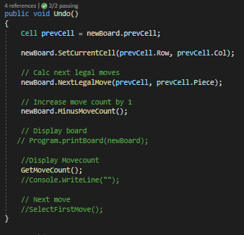
Feature 13 – Must have undo
Game.cs

Slide 30
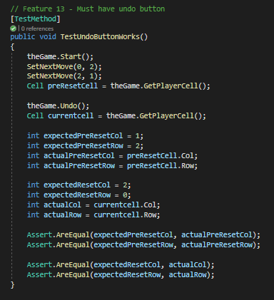
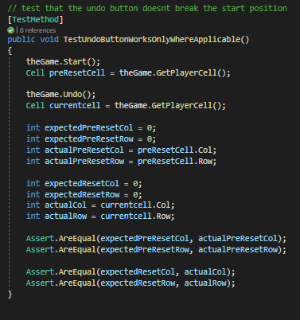
Test 25/26 – Must have undo

Slide 31
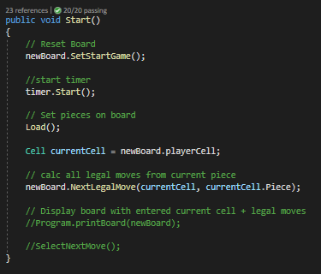

Feature 14 – Must have Reset
Game.cs

Slide 32
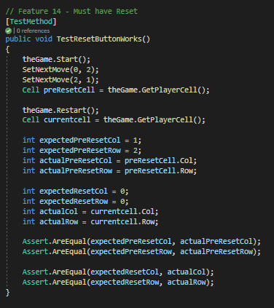
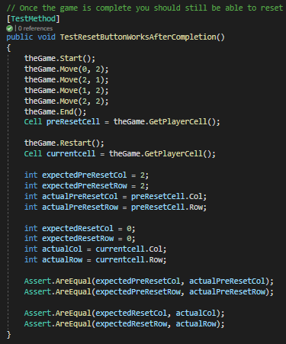
Test 27/28 – Must have Reset

Slide 33
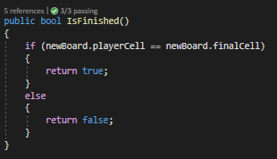
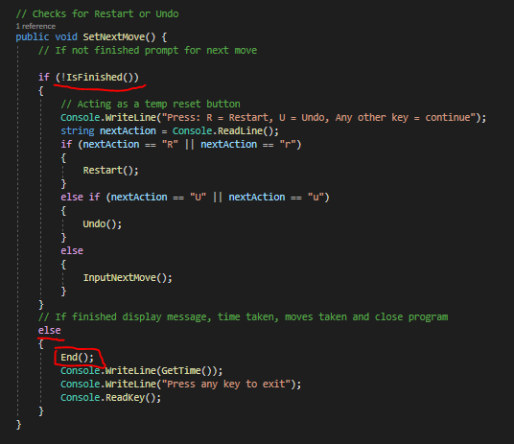

Feature 15 – Must acknowledge level completion
Game.cs

Slide 34
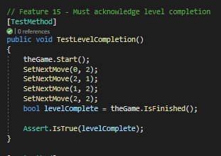

Test 29/30 – Must acknowledge level completion

Slide 35



Feature 16 – Must Display time taken
Game.cs

Slide 36


Test 31/32 – Must acknowledge level completion

Slide 37

All Tests Pass

